Slide 1
Unit 4 assignment 2
Notes:
27/02/24
27/02/24

Slide 2
Flowchart part b
start
4/20/5 team
Here is my flowchart showing how my program works and all the stages
Run the tournament
Who wins ??
verdict
Notes:
27/02/24
27/02/24

Slide 3
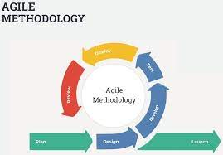
Software development life cycle
I will follow the agile methodology to assist with software design and implementation of it and I will do a test plan.I will also detailed requirements from the college regarding the tournament scoring system. I will determine the functionality needed for managing participant registrations, event scoring, and result generation. I Identify any specific constraints or preferences for the system.
Notes:
27/02/24
27/02/24

Slide 4

Design Specification
I will design a system architecture for the scoring system application , I will also include a components
For participant management event handling and scoring algorithm and result generation .This will also includes the names of each team that will be participating in the each tournament and also the names of players listed in each team
Notes:
27/02/24
27/02/24

Slide 5
The review of what I will do
I review the pseudo-code I found some error which I will fix error in the real code I will keep a test log for all error to ensure my code runs well ,what will I test I'll test the that the variables within the scoring system works and that all the team name display and that it totals at the end the score I will use python Thonmy as ui
Notes:
27/02/24
27/02/24

Slide 6
Review the final design
After reviewing the code I can see it has a clear ui showing weather your entering as a group or individual
After entering a name in the name field it has a pop up text showing the team name that was entered.
I wouldn't make any changes as it is easy to read which is good on usability. (Jack)
Notes:
27/02/24

Slide 7
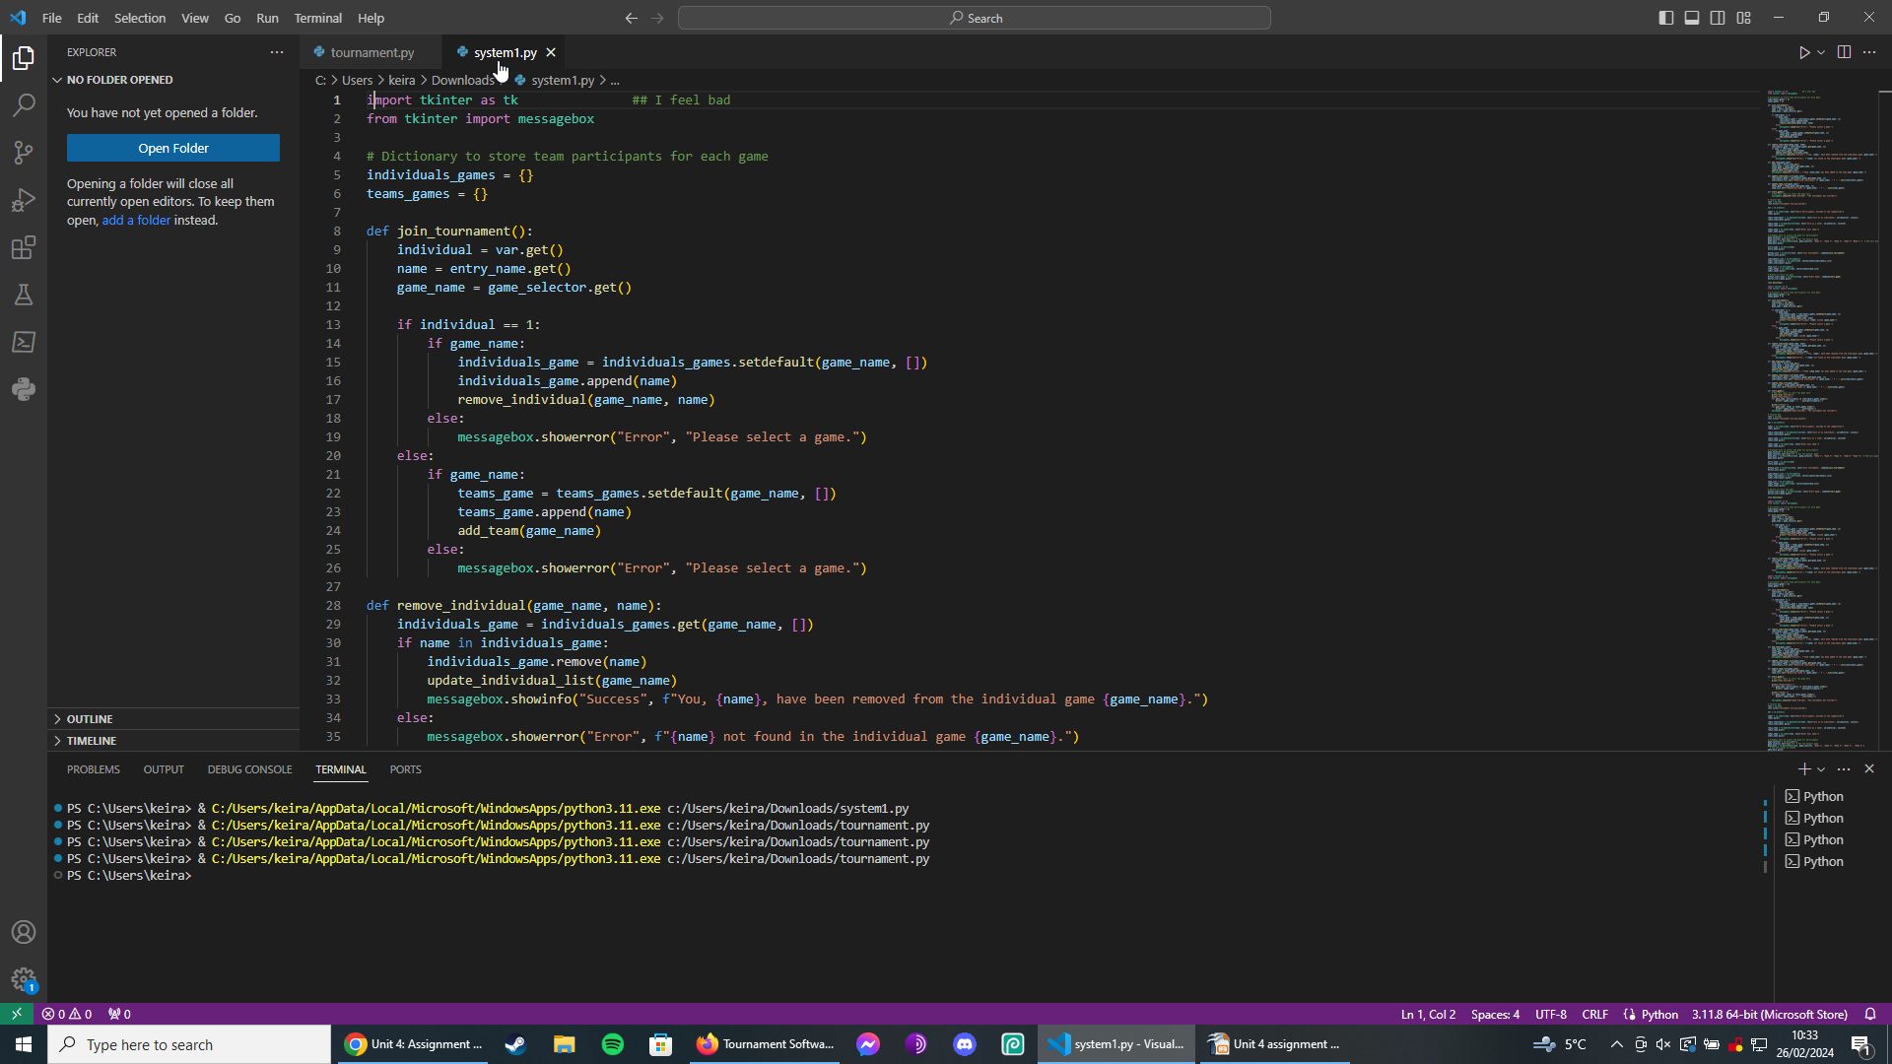
review of the pseudo-code
Here’s is my pseudo-code , this shows the numbers teams and the matches been played . At the end , it also shows the update scores of the natch results .
Notes:
27/02/24
27/02/24

Slide 8
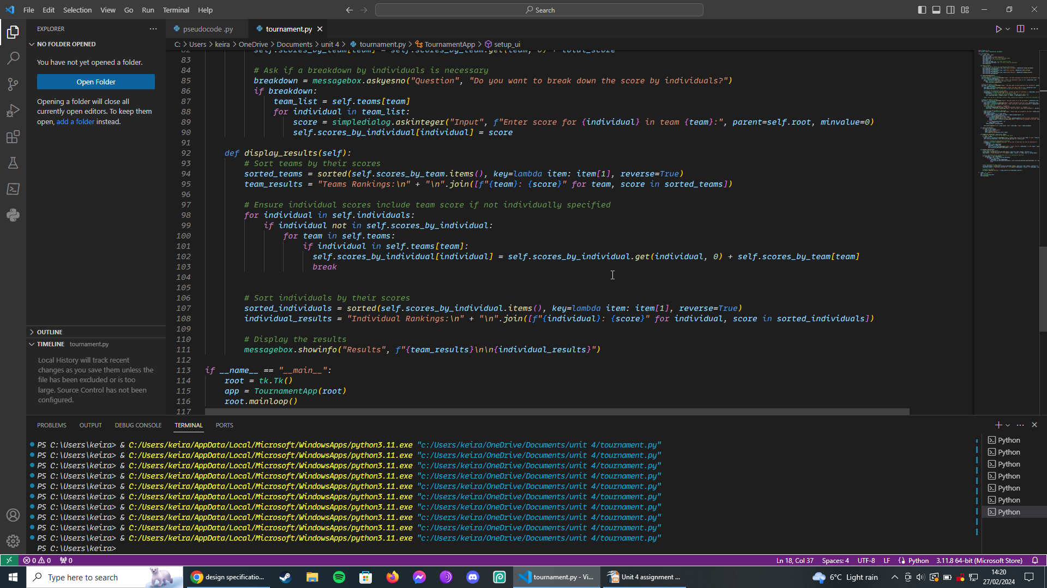
Test 1 line 103
Was suck in loop had to use a python brake to end the loop

Slide 9
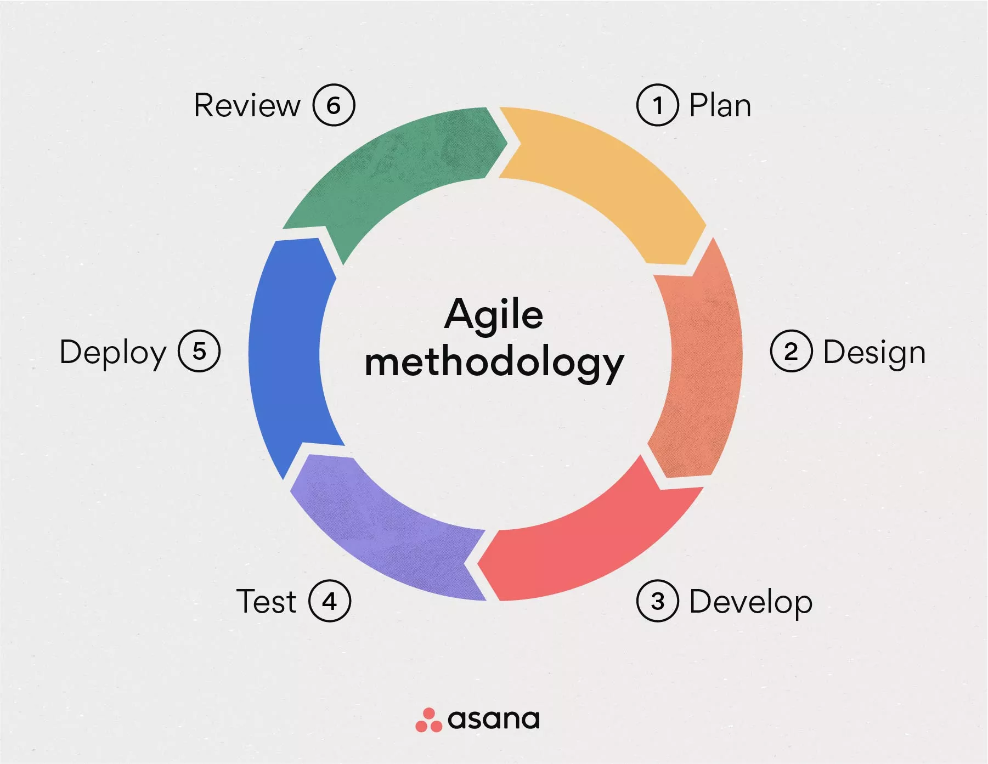
agile methodology
I have followed the agile methodology to help me developed my software
by plan the software the software first then I design it by following the
flowchart then testing it and making log to test it deploy it I reviewed it.

Slide 10
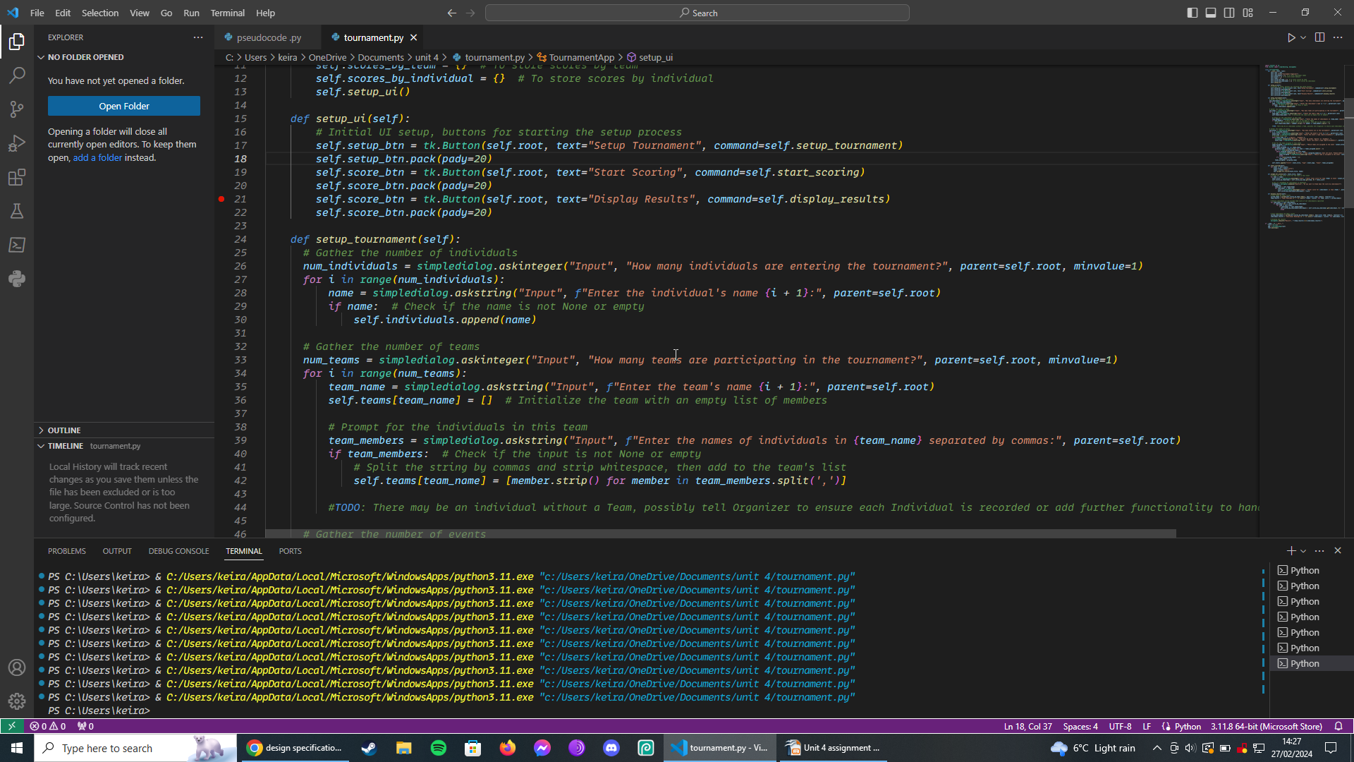
Test 2 line 35
Had to use a F string to input the names

Slide 11
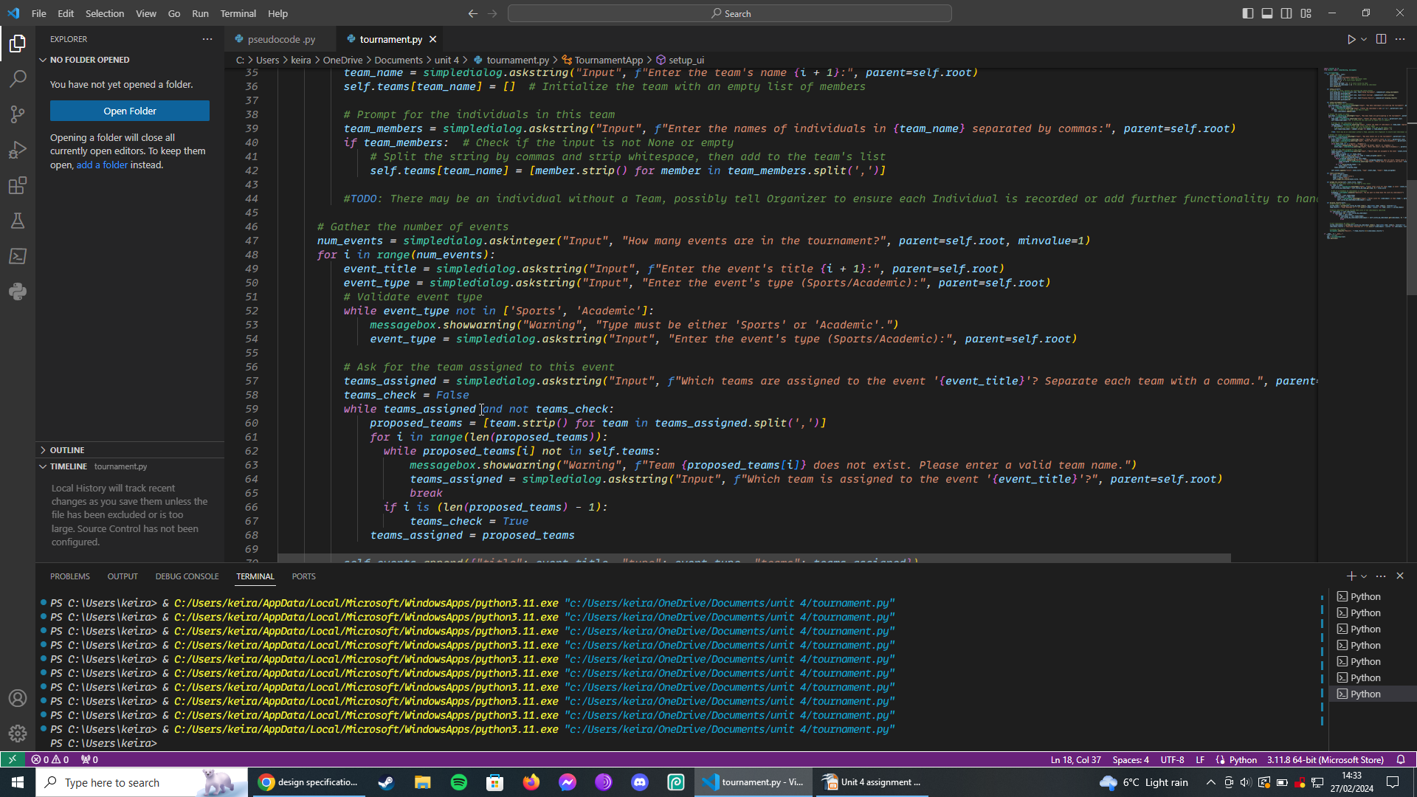
Test 3 line 48
Line 48 to line 54 could cause a buffer overflow I am not sure not to fix it

Slide 12
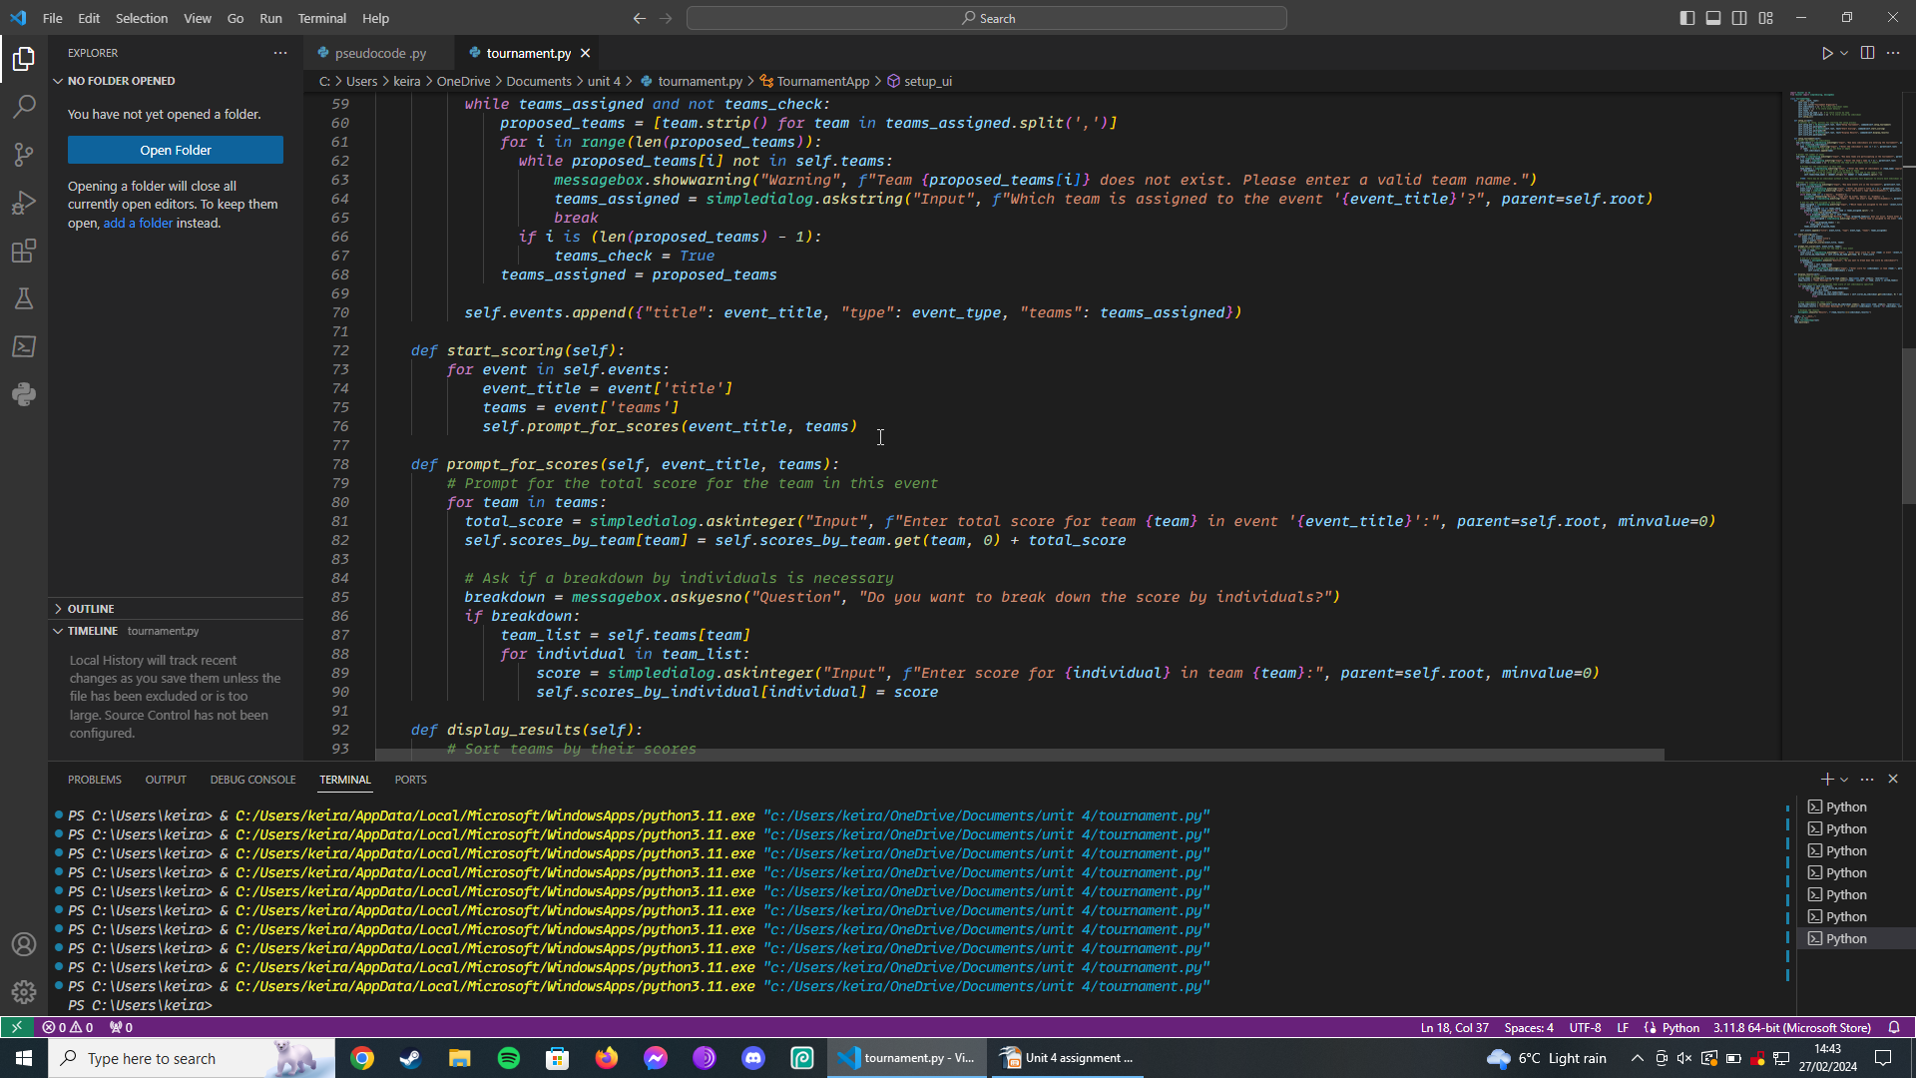
Test 4 line 75
Had to change team to teams

Slide 13
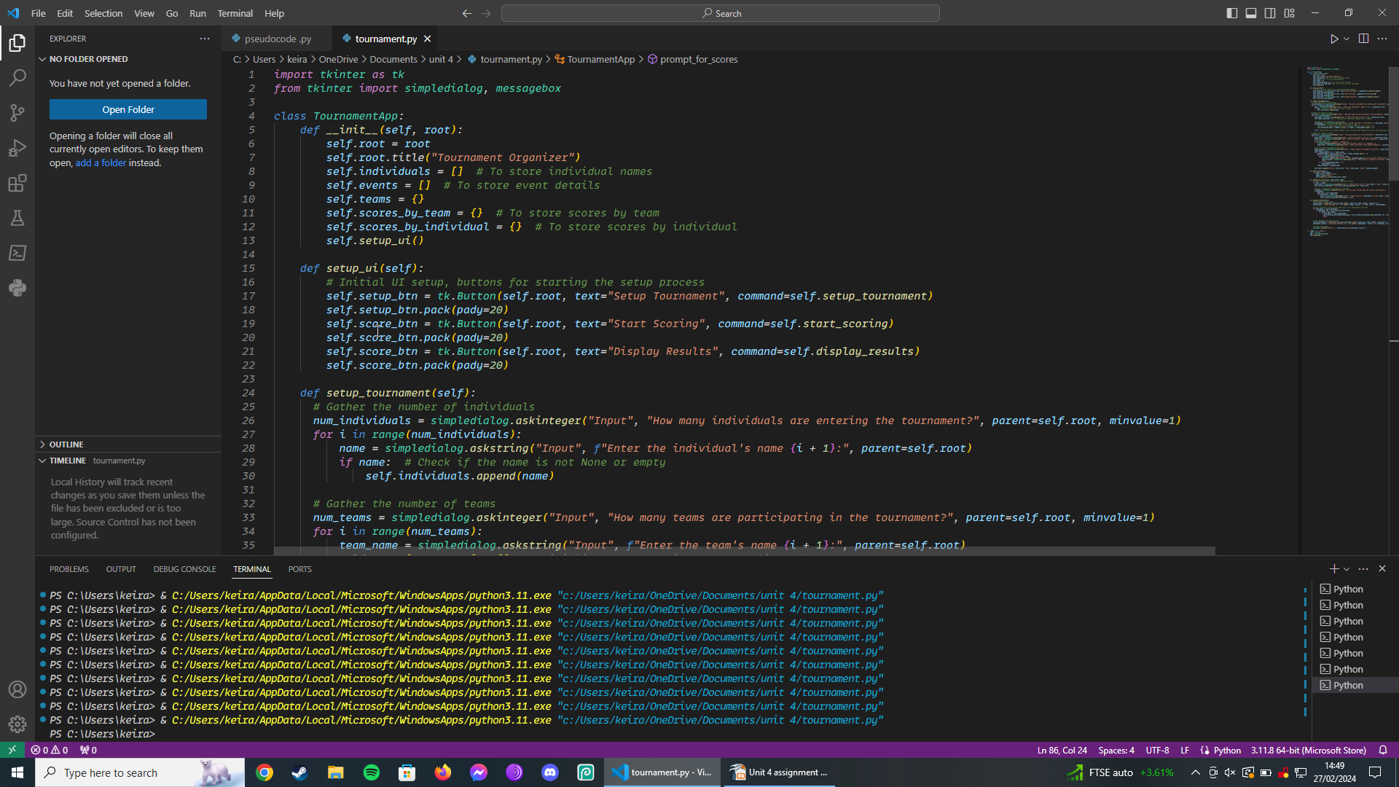
Test 5 line 28
I had to use a range number variables to add
up to the numbers of users

Slide 14
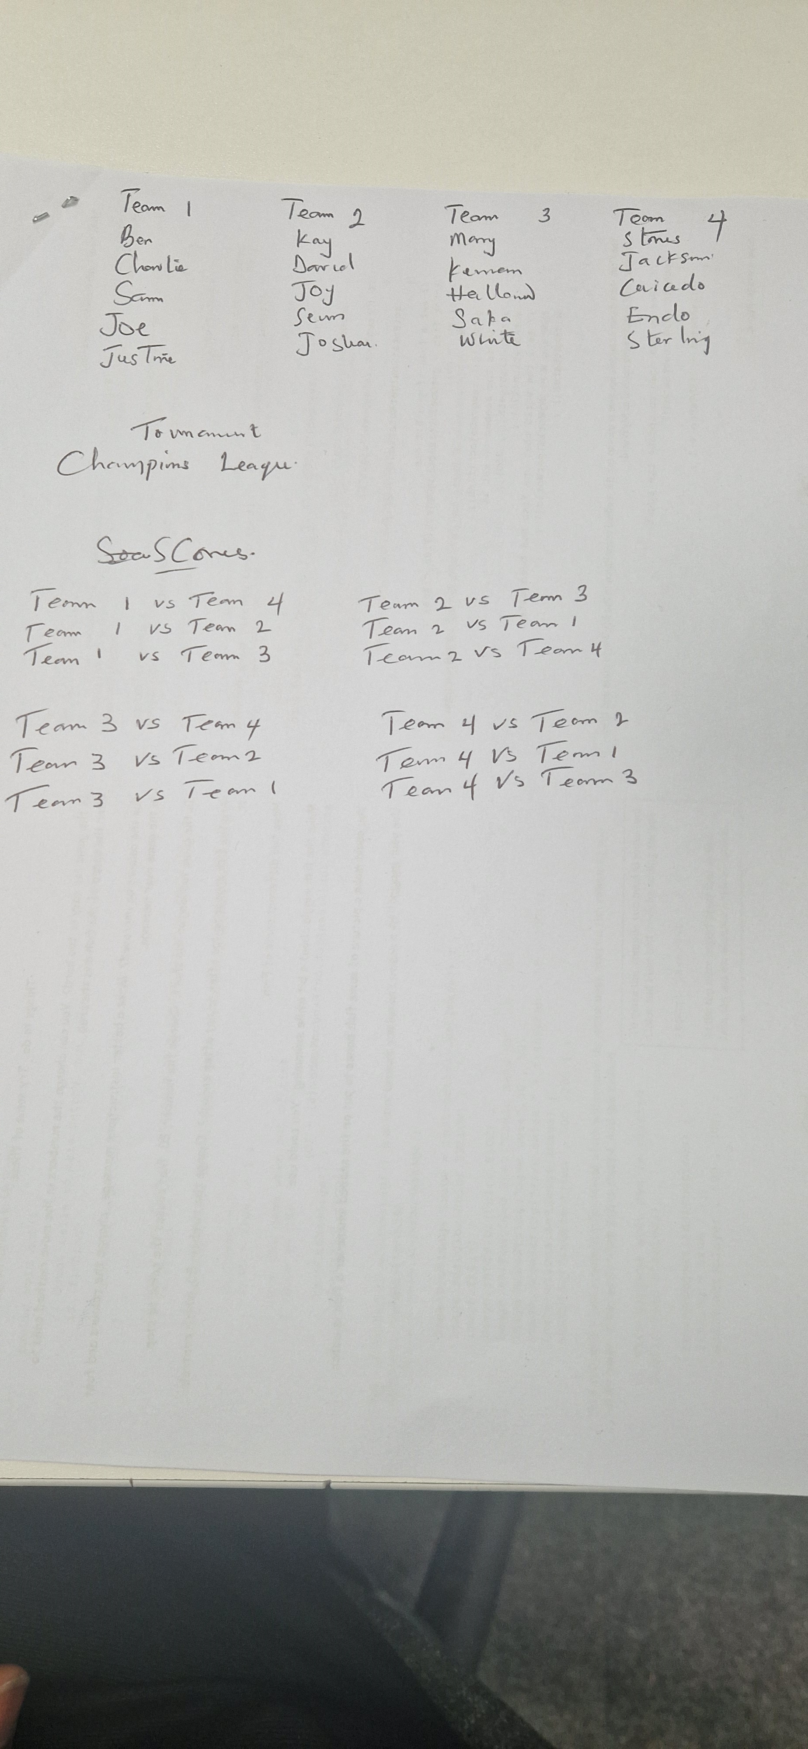
A cross section of how each team was set up
A picture of each teams with the names of players listed in each team and also the tournament they participated in

Slide 15
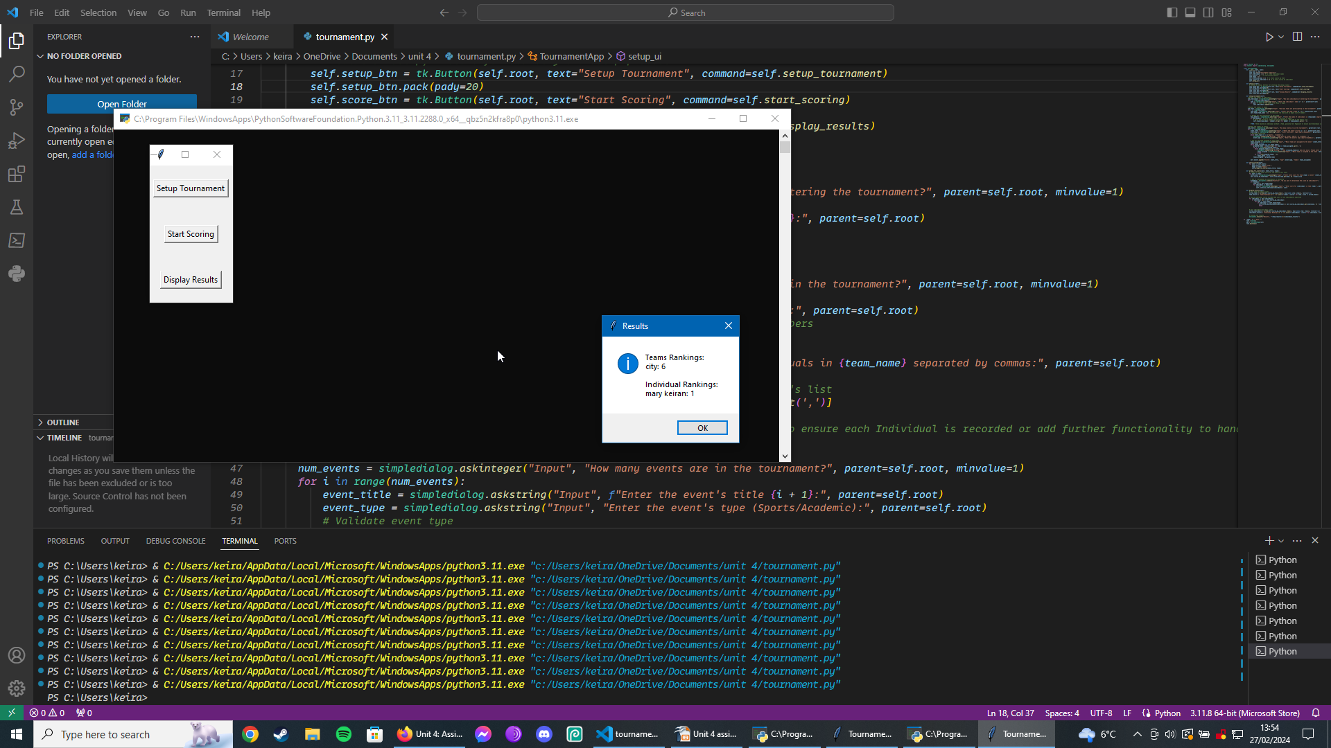
EVIDENCE TO SHOW THAT MY PROGRAM IS RUNNING

Slide 16
Review of my final code
I have tailored the software to meet the specific needs of the company by make my code easy to read and easy to run.
However the syntax can be difficult to read, there's a buffer overflow on line 48 that I could fix but I don’t feel it would have a huge impact on the overall software therefore it is not necessary to amend this.
My use of GUI rather than UI has meant it is more eye catching although I acknowledge that it is more graphically demanding I felt it was the right choice to make to ensure I fully met the company’s specifications.
Notes:
27/02/24

